Slide 1
Connection diagram
VM1 – Open5gs
VM2 – srsRAN
eth0
eth0
SSH
Switch
SSH
Internet
VM3 – Ansible
eth0
Ansible Automation Engine
Playbooks
Inventory
Modules
Roles

Slide 2
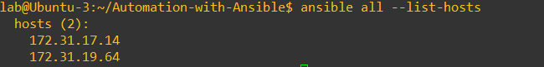
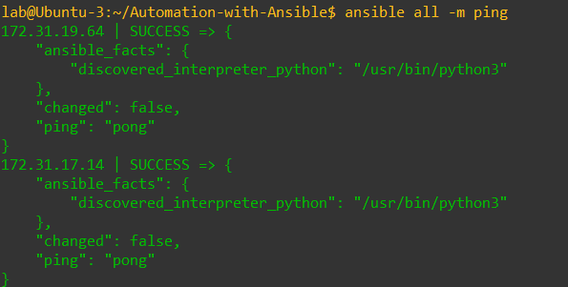
Hosts list and ping to all hosts

Slide 3
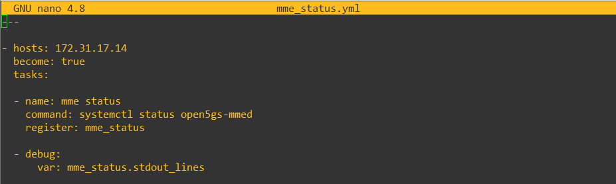
Playbook: mme_status.yml

Slide 4
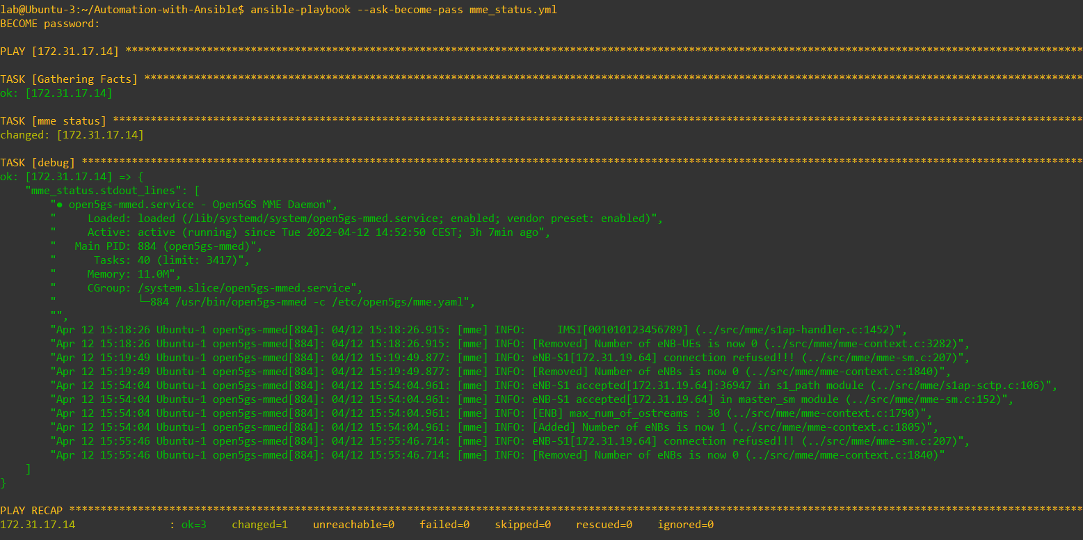
mme_status output

Slide 5
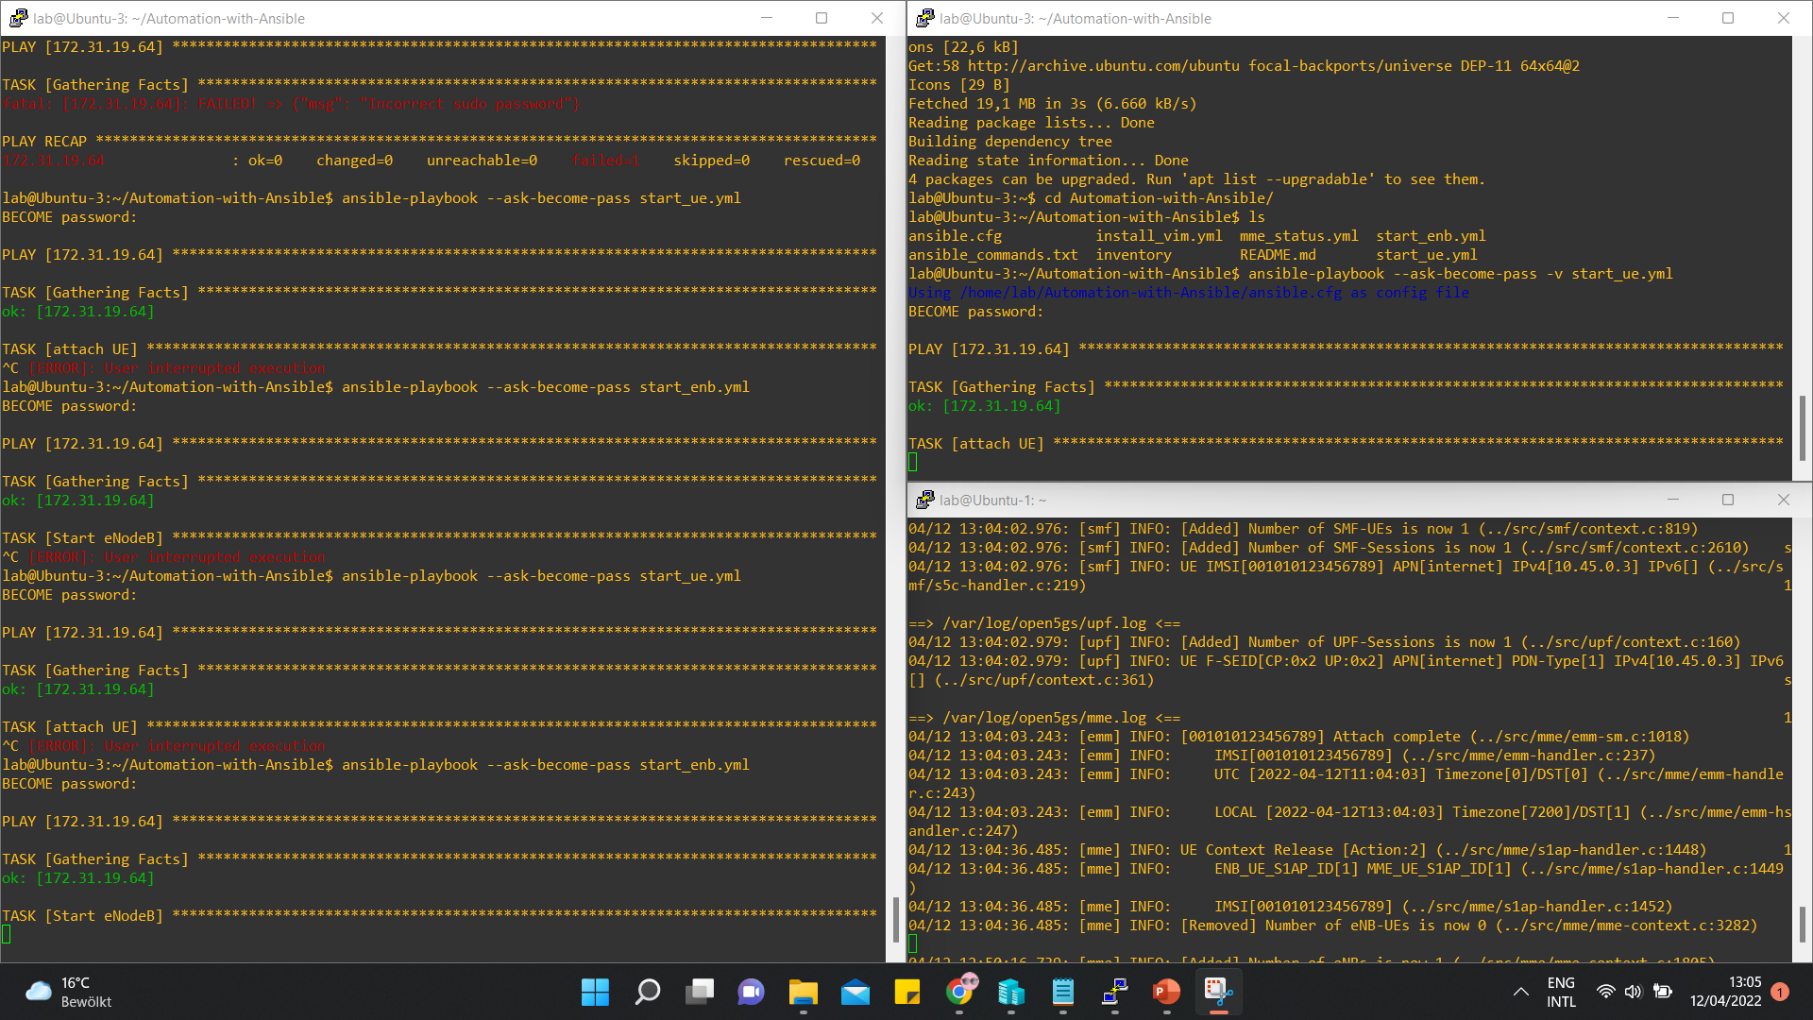
Starting eNodeB and attaching UE

